Slide 1
Haytor Hoppa – Formula 1 but not sustainable?
Richard Drysdale
28 September 2012

Slide 2
Formula 1?

Slide 3
Haytor Hoppa
Introduction
Trials and tribulations
Year 2 onwards
Successful services
2013 and beyond?

Slide 5
Haytor Hoppa
Introduction
20 mile circular route
leisure opportunities
extended season
attractive pricing
more than a journey
support from various sources

Slide 6
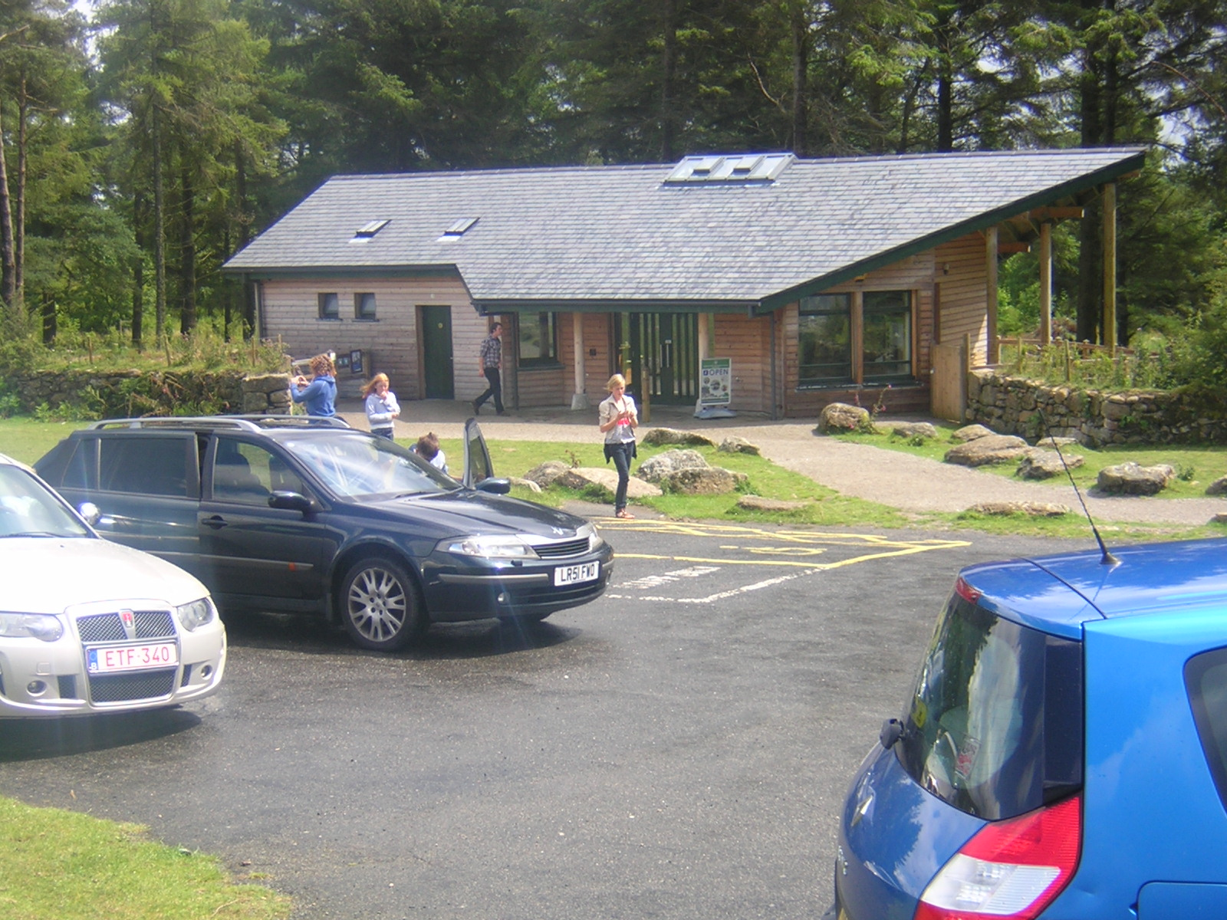
Dartmoor in 2020?

Slide 8
Haytor Hoppa
Trials and tribulations
registering service
quality of transport
passenger confidence
business engagement
day of operation
weather

Slide 10
Year 2 onwards (2010 – 2012)
Saturday Service starting at Easter
Additional service
Guided Walks
Increased promotion
Product development

Slide 11
Treasure Trails – family activity packs

Slide 12
Evening Excursions – business engagement

Slide 13
Successful Services
Cost
Continuity
Confidence
Community
Communication

Slide 15
Haytor Hoppa
Hoppa 2013 and beyond
working without LSTF monies wider business engagement
increased connections
increased operation
further work with new rail franchise

Slide 16
Dartmoor in 2020

